Slide 1

Programming on Python
Lecture 15
Program Efficiency
Complied by
Aizhan Altaibek

Slide 2
Content
What is an efficiency of programs?
Evaluation of efficiency of programs
Analyzing programs and their complexity
Optimization Tips for Python Code

Slide 3
WANT TO UNDERSTAND EFFICIENCY OF PROGRAMS
computers are fast and getting faster — so maybe efficient programs don’t matter?
but data sets can be very large (e.g., in 2014, Google served 30,000,000,000,000 pages, covering 100,000,000 GB – how long to search brute force?)
thus, simple solutions may simply not scale with size in acceptable manner
how can we decide which option for program is most eﬃcient?
separate time and space eﬃciency of a program
tradeoﬀ between them:
can sometimes pre-compute results are stored; then use “lookup” to retrieve (e.g., memoization for Fibonacci)
will focus on time eﬃciency

Slide 4
WANT TO UNDERSTAND EFFICIENCY OF PROGRAMS
Challenges in understanding eﬃciency of solution to a computational problem:
a program can be implemented in many diﬀerent ways
you can solve a problem using only a handful of diﬀerent algorithms
would like to separate choices of implementation from choices of more abstract algorithm

Slide 5

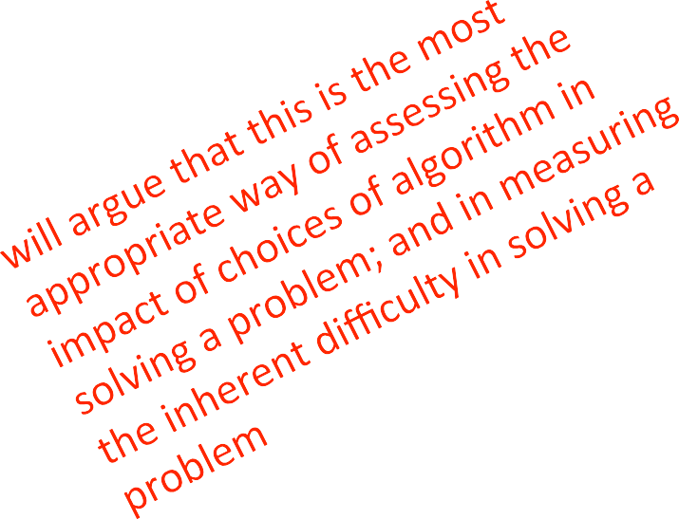
HOW TO EVALUATE EFFICIENCY OF PROGRAMS
measure with a timer
count the operations
abstract notion of order of growth

Slide 6
TIMING A PROGRAM
use time module
recall that importing means to bring in that class into your own ﬁle
start clock
call function
stop clock
import time
def c_to_f(c):
return c*9/5 + 32
t0 = time.clock()
c_to_f(100000)
t1 = time.clock() - t0
t1,
Print("t =", t, ":",
"s,”)

Slide 7
TIMING PROGRAMS IS INCONSISTENT
GOAL: to evaluate diﬀerent algorithms
running time varies between algorithms
running time varies between implementations
running time varies between computers
running time is not predictable based on small inputs
time varies for diﬀerent inputs but cannot really express a relationship between inputs and time

Slide 8

COUNTING OPERATIONS
assume these steps take
constant time:
mathematical operations
comparisons
assignments
accessing objects in memory
then count the number of operations executed as function of size of input
def c_to_f(c):
return c*9.0/5 + 32
def mysum(x):
total = 0
 | i in range(x+1):
 | total += i
for
return total
mysum à 1+3x ops

Slide 9
COUNTING OPERATIONS IS BETTER, BUT STILL…
GOAL: to evaluate diﬀerent algorithms
count depends on algorithm
count depends on implementations
count independent of computers
no clear deﬁnition of which operations to count
count varies for diﬀerent inputs and can come up with a relationship between inputs and the count

Slide 10
STILL NEED A BETTER WAY
timing and counting evaluate implementations
timing evaluates machines
want to evaluate algorithm
want to evaluate scalability
want to evaluate in terms of input size
10

Slide 11
STILL NEED A BETTER WAY
Going to focus on idea of counting operations in an algorithm, but not worry about small variations in implementation (e.g., whether we take 3 or 4 primitive operations to execute the steps of a loop)
Going to focus on how algorithm performs when size of problem gets arbitrarily large
Want to relate time needed to complete a computation, measured this way, against the size of the input to the problem
Need to decide what to measure, given that actual number of steps may depend on speciﬁcs of trial

Slide 12
NEED TO CHOOSE WHICH INPUT TO USE TO EVALUATE A FUNCTION
want to express eﬃciency in terms of size of input, so need to decide what your input is
could be an integer
-- mysum(x)
could be length of list
-- list_sum(L)
you decide when multiple parameters to a function
-- search_for_elmt(L, e)

Slide 13
DIFFERENT INPUTS CHANGE HOW THE PROGRAM RUNS
a function that searches for an element in a list
def search_for_elmt(L, e): for i in L:
if i == e:
return True False
return
when e is ﬁrst element in the list à BEST CASE
when e is not in list à WORST CASE
when look through about half of the elements in list à AVERAGE CASE
want to measure this behavior in a general way

Slide 14

BEST, AVERAGE, WORST CASES
suppose you are given a list L of some length len(L)
best case: minimum running time over all possible inputs of a given size, len(L)
constant for search_for_elmt
ﬁrst element in any list
average case: average running time over all possible inputs of a given size, len(L)
practical measure
worst case: maximum running time over all possible inputs of a given size, len(L)
linear in length of list for search_for_elmt
must search entire list and not ﬁnd it

Slide 15
ORDERS OF GROWTH
Goals:
want to evaluate program’s eﬃciency when input is very big
want to express the growth of program’s run time as input size grows
want to put an upper bound on growth – as right as possible
do not need to be precise: “order of” not “exact” growth
we will look at largest factors in run time (which section of the program will take the longest to run?)
thus, generally we want right upper bound on growth, as function of size of input, in worst case

Slide 16
MEASURING ORDER OF GROWTH: BIG O NOTATION
Big Oh notation measures an upper bound on the asymptotic growth, oien called order of growth
Big Oh or O() is used to describe worst case
worst case occurs oien and is the boLleneck when a program runs
express rate of growth of program relative to the input size
evaluate algorithm NOT machine or implementation

Slide 17
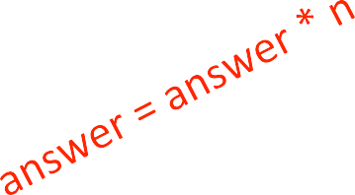
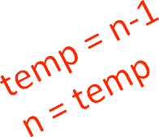
EXACT STEPS vs O()
def fact_iter(n):
"""assumes n an int answer = 1
while n > 1:
>= 0"""
answer *= n n -= 1
return answer
computes factorial
number of steps:
worst case asymptotic complexity:
ignore additive constants
ignore multiplicative constants

Slide 18
WHAT DOES O(N) MEASURE?
Interested in describing how amount of time needed grows as size of (input to) problem grows
Thus, given an expression for the number of operations needed to compute an algorithm, want to know asymptotic behavior as size of problem gets large
Hence, will focus on term that grows most rapidly in a sum of terms
And will ignore multiplicative constants, since want to know how rapidly time required increases as increase size of input

Slide 19
SIMPLIFICATION EXAMPLES
drop constants and multiplicative factors
focus on dominant terms
_{n}2 _{n}2
)
: + 2n + 2
: + 100000n +
: log(n) + n + 4
:
:
2
O(n
)
₃1000
2
O(n
O(n)
O(n log n)
0.0001*n*log(n)
+ 300n
)
_{2n}30 ₃n
n
+
O(3

Slide 20
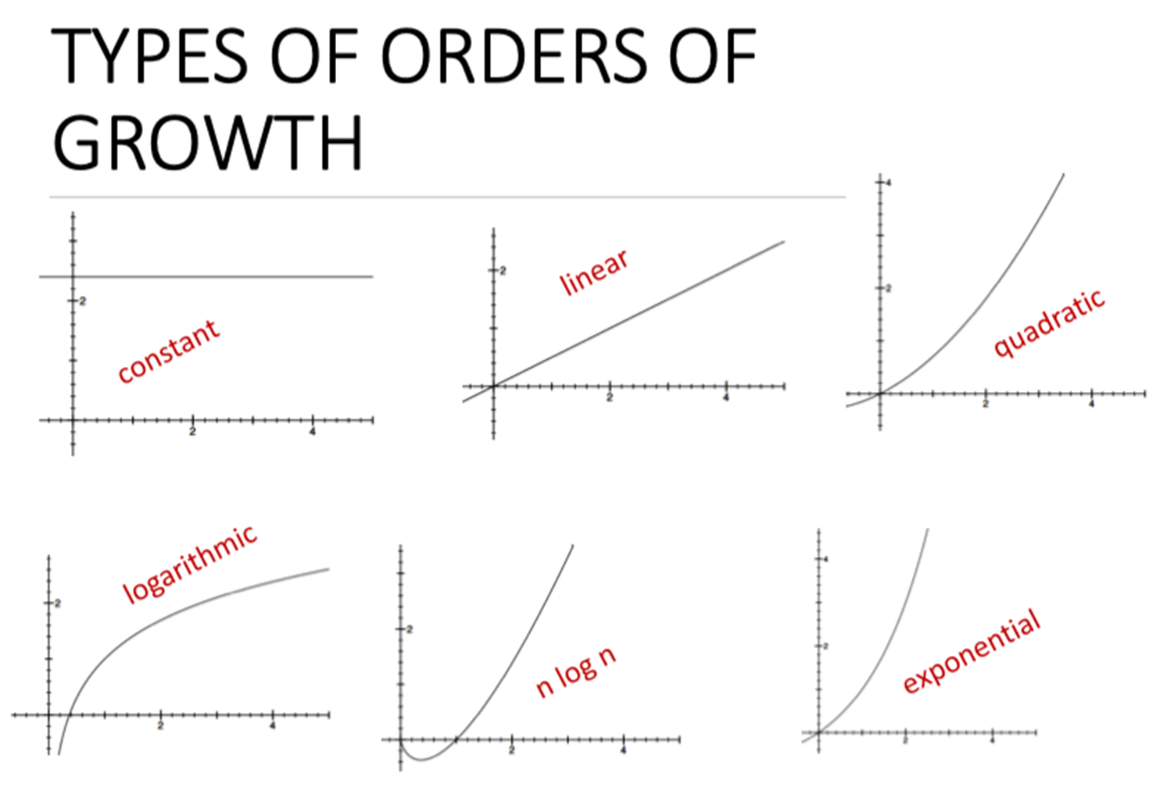
20

Slide 21
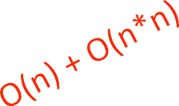
ANALYZING PROGRAMS AND THEIR COMPLEXITY
combine complexity classes
analyze statements inside functions
apply some rules, focus on dominant term
Law of Addition for O():
used with sequential statements
• O(f(n)) + O(g(n)) is O( f(n) + g(n) )
for example,
for i in range(n): print('a')
for j in range(n*n):
print('b')
is O(n) + O(n*n) = O(n+n²) = O(n²) because of dominant term
21

Slide 22
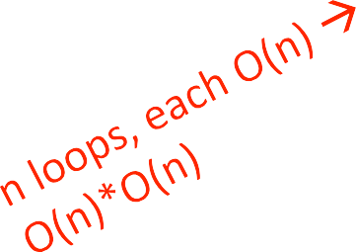
ANALYZING PROGRAMS AND THEIR COMPLEXITY
combine complexity classes
analyze statements inside functions
apply some rules, focus on dominant term
Law of Multiplication for O():
used with nested statements/loops
• O(f(n)) * O(g(n)) is O( f(n) * g(n) )
for example,
for i in range(n):
for j in range(n): print('a')
is O(n)*O(n) = O(n*n) = O(n²) because the outer loop goes n times and the inner loop goes n times for every outer loop iter.

Slide 23
COMPLEXITY CLASSES
O(1) denotes constant running time
O(log n) denotes logarithmic running time
O(n) denotes linear running time
O(n log n) denotes log-linear running time
O(n^{c}) denotes polynomial running time (c is a constant)
O(c^{n}) denotes exponential running time (c is a constant being raised to a power based on size of input)

Slide 24
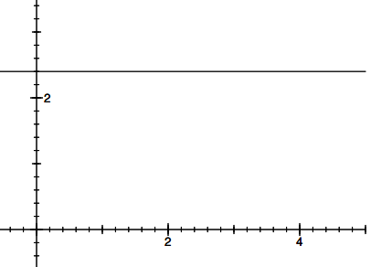
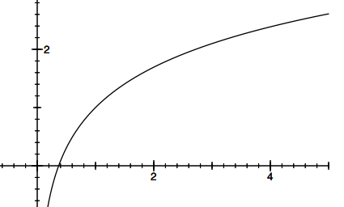
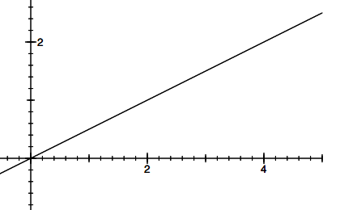
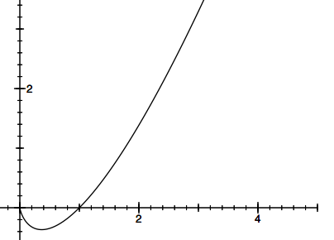
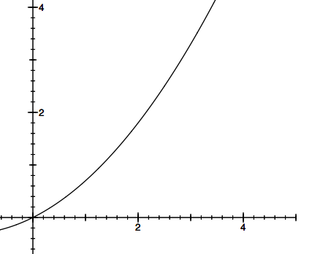

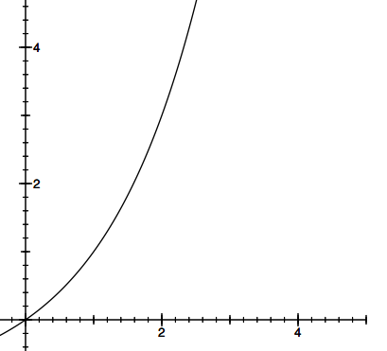
COMPLEXITY CLASSES ORDERED LOW TO HIGH
:
constant
logarithmic linear loglinear polynomial exponential
O(1)
O(log n) :
O(n)
O(n log n): O(n^{c})
O(c^{n})
:
:
:

Slide 25

COMPLEXITY GROWTH
CLASS | n=10 | = 100 | = 1000 | = 1000000
O(1) | 1 | 1 | 1 | 1
O(log n) | 1 | 2 | 3 | 6
O(n) | 10 | 100 | 1000 | 1000000
O(n log n) | 10 | 200 | 3000 | 6000000
O(n^2) | 100 | 10000 | 1000000 | 1000000000000
O(2^n) | 1024 | 12676506 | 1071508607186267320948425049060 | Good luck!!
 |  | 00228229 | 0018105614048117055336074437503
 |  | 40149670 | 8837035105112493612249319837881
 |  | 3205376 | 5695858127594672917553146825187
 |  |  | 1452856923140435984577574698574
 |  |  | 8039345677748242309854210746050
 |  |  | 6237114187795418215304647498358
 |  |  | 1941267398767559165543946077062
 |  |  | 9145711964776865421676604298316
 |  |  | 52624386837205668069376

Slide 26
Optimization Tips for Python Code

Slide 27
Data structures
Know the basic data structures
it is often a good idea to use sets or dictionaries instead of lists in cases where:
The collection will contain a large number of items
You will be repeatedly searching for items in the collection
You do not have duplicate items.

Slide 28
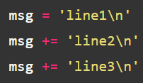

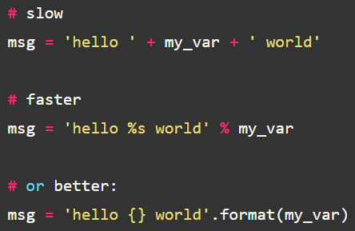
Reduce memory footprint
This is inefficient because a new string gets created upon each pass. Use a list and join it together:
Avoid the + operator on strings:

Slide 29
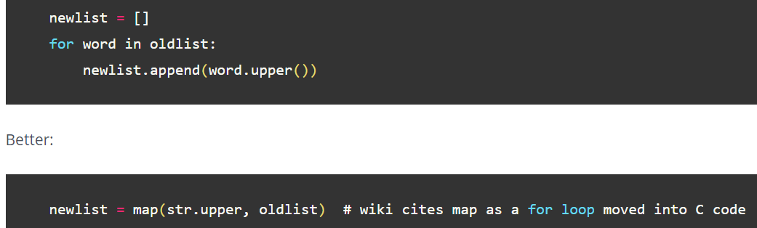
Use builtin functions and libraries
Builtin functions like sum, max, any, map, etc are implemented in C. They are very efficient and well tested.

Slide 30
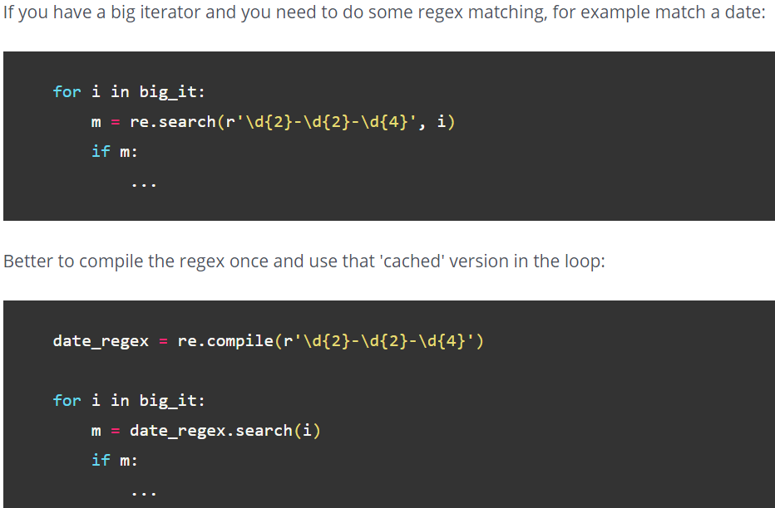
Move calculations outside the loop

Slide 31
Keep your code base small
Common sense but still: be conscious what you put in the module vs main level (latter being below the __main__ statement). When you import a module potentially a lot of code runs and can slow down your program!
Reduce the amounts of if/elif/and/or. An interesting example here this great talk: the ask forgiveness code style might run faster because it eliminates the need for the if check.
Update: on the mentioned Reddit thread we got some feedback on try/except vs 'if os.path.isfile', latter might actually be better.
Notes:
https://pybit.es/faster-python.html

Slide 32
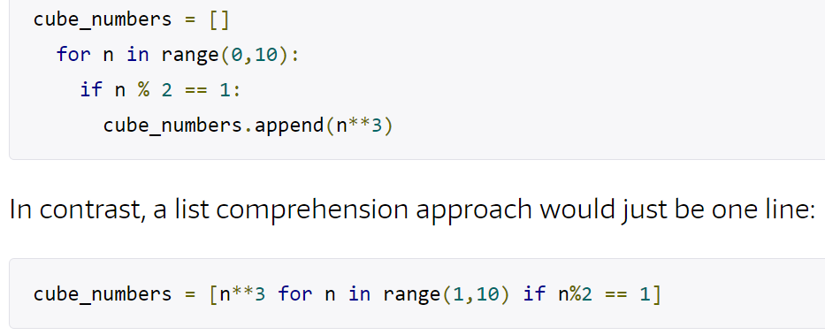
Use list comprehensions
When you’re working in Python, loops are common. You’ve probably come across list comprehensions before. They’re a concise and speedy way to create new lists.
For example, let’s say you wanted to find the cubes of all the odd numbers in a given range. Using a for loop, that task might look like this:
Notes:
https://pybit.es/faster-python.html

Slide 33
Other recommendations
Use xrange() instead of range()
Use “in” if possible.
Remember to use multiple assignment
Avoid global variables.
Keep up-to-date on the latest Python releases.
and others https://stackify.com/20-simple-python-performance-tuning-tips/

Slide 34


